Slide 1




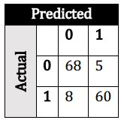
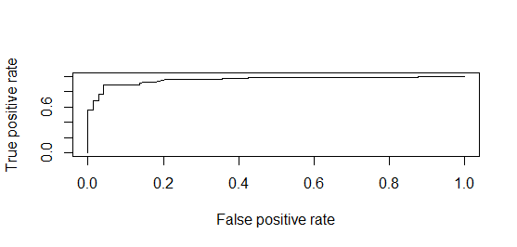
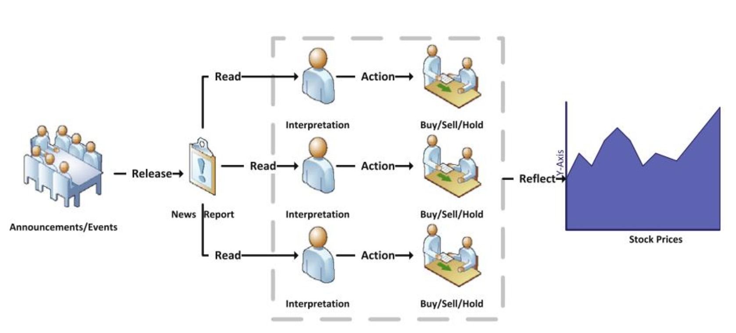
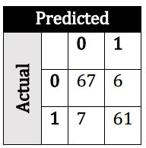
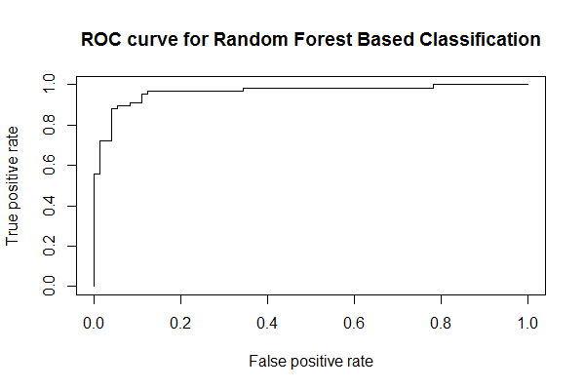
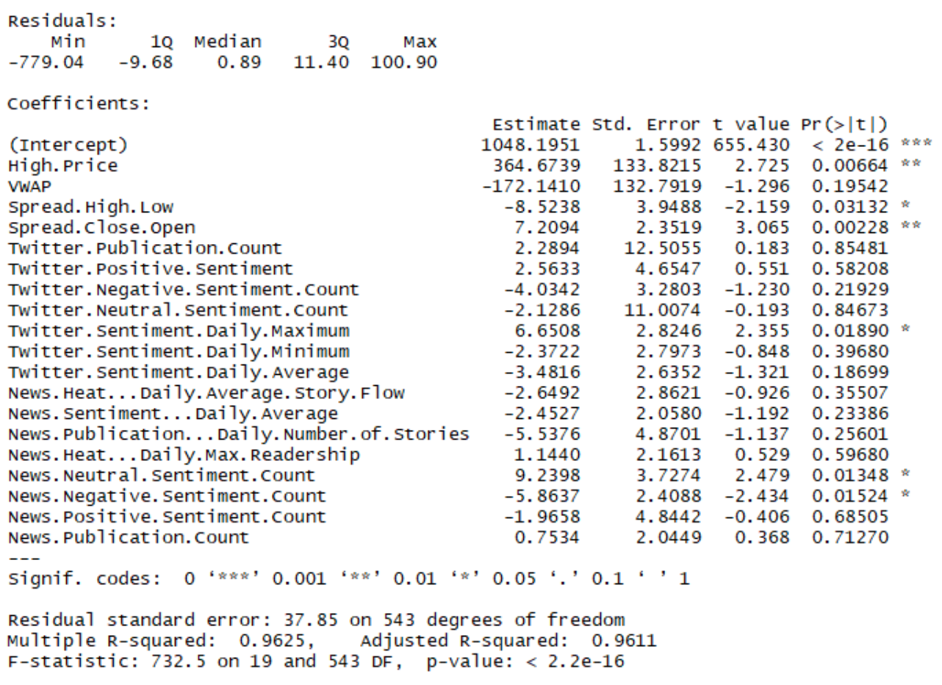
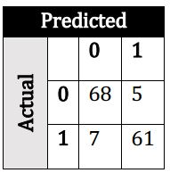

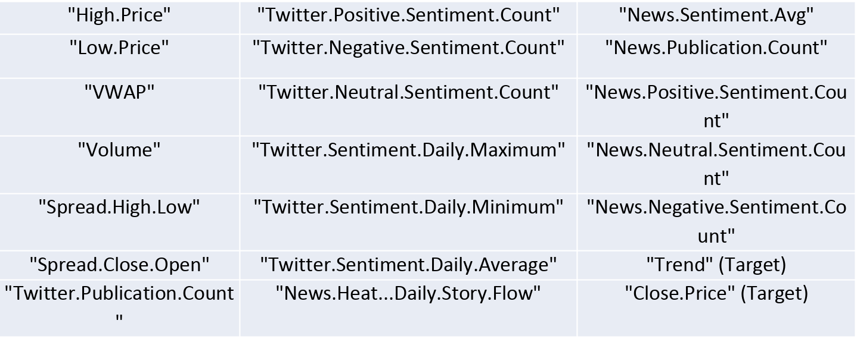
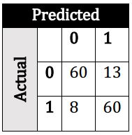
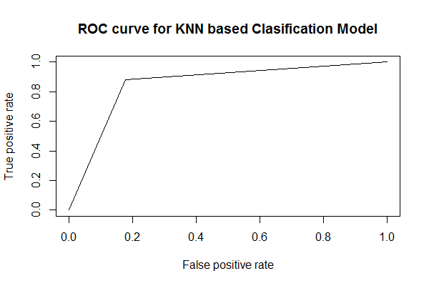
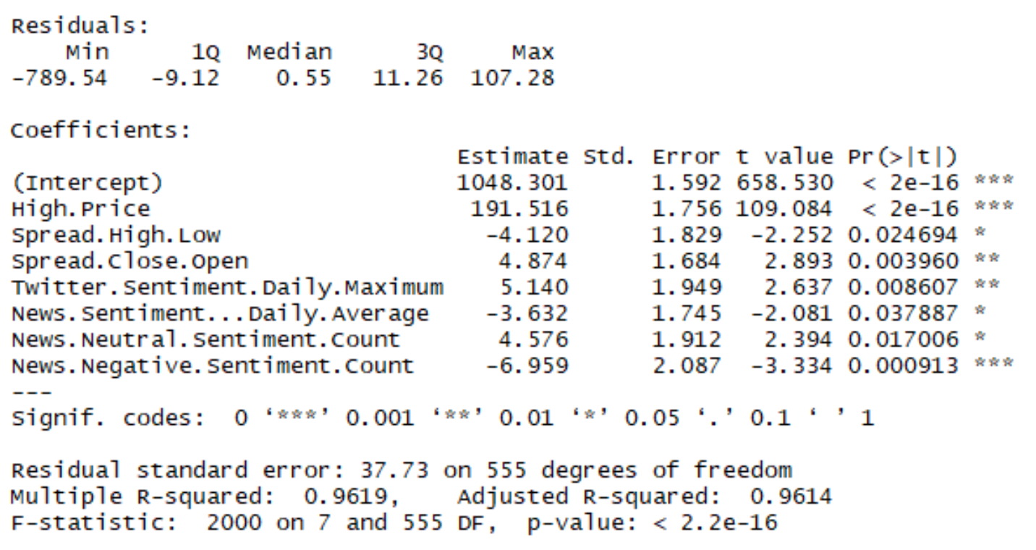
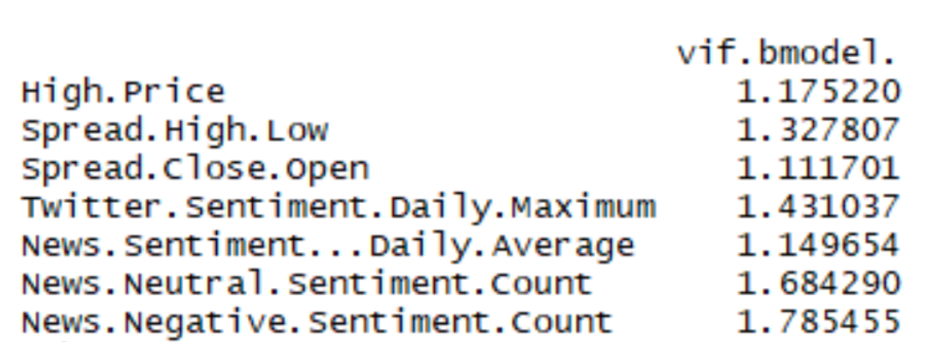
Impact of Financial News & Sentiments on Stock Prices
Aradhya Kasat | kasata@rpi.edu
¹ Rensselaer Polytechnic Institute, Tetherless World Constellation, Troy, NY, United States,
Abstract
Exploratory Analysis
Classification Analysis
Stock Market is an important part of nowadays financial market. So everyone involved including the investors and speculators in the market would like to make better profits by analyzing market information. Building accurate model is difficult as variation in price depends on multiple factors such as news, social media data, and fundamentals, production of the company, government bonds, historical price and country’s economics. Prediction model which considers only one factor might not be accurate. Hence incorporating multiple factors including news, social media data and historical price might increase the accuracy of the model.
Fig. 1: ﻿General scenario of news impact on prices
Financial news articles, are known as one of the major source of market information, are widely used and analyzed by investors. News articles are first interpreted by investors and translated into market sentiments, the investors then make their decisions based on the sentiment interpretations; and market prices aggregate the actions of each investor and reflect them in the final price movements. Therefore, integrating the sentiment analysis into the prediction framework would become more critical.
Bivariate Analysis on trend:
Fig. 3: Box plots with trend
Correlation Matrix:
Modelling trend with sentiment factors using various classification algorithms.
a) Logistic Regression:
Table 2: Confusion matrix for Logistic Regression
Accuracy: 90.8%
Fig. 8: ROC Curve for Logistic Regression
b) Random Forest:
Table 3: Confusion matrix for Random Forest Accuracy: 90.78% Fig. 9: ROC Curve for Random Forest
c) Neural Network:
Table 4: Confusion matrix for Neural Network
Accuracy: 91.49%
Fig. 10: ROC Curve for Neural Network
d) KNN:
Table 5: Confusion matrix for K Nearest Neighbor
Accuracy: 85.11%
Fig. 11: ROC Curve for KNN
Fig. 4: Correlation Matrix
Regression Analysis
Basic Linear Model: Modelling Close price with sentiment factors using multiple regression model.
Fig. 5: Basic Linear Model Summary
Backward Linear Model: Modelling close price with sentiment values based on an iterative regression model:
Fig. 6: Backward Linear Model Summary
VIF for Backward Model
Fig. 7: VIF Values for Backward Regression
VIF values close to 1 indicate removal of multi-collinearity in the dataset.
Dataset
Source: Bloomberg Terminal, Yahoo Finance
No. of Observations: 704 (3 years of Data for RIL)
No. of Variables: 22 (Sentiment Scores, Stock Data)
Table 1: ﻿Dataset Features
Exploratory Analysis
Univariate Analysis:
Fig. 2: Distributions of sentiment related variables
Results & Conclusion
Dataset features like news sentiment score, twitter sentiment etc. are significant as implied by backward selection model
For the classification task, Neural Network turned out to be the best model with highest AUC (0.9149)
For the regression task, Backward Selection model performed better than basic regression with RMSE value of 50.06
Implementation of more machine learning algorithms like Gradient boosting, evolutionary algorithms, ensembles and hybrid models
Inclusion of new features like website traffic, macro-economic factors, social score of firms etc.
Expanding the scope of project to other asset classes like commodities etc.
Future Work
Sponsors:
Glossary:
RIL – Reliance Industries Limited is an Indian publicly traded stock
VIF – Variance Inflation Factor quantifies severity of multicollinearity in a dataset
ROC Curve – Receiver Operator Characteristic Curve indicates diagnostic ability of a classifier
KNN - K Nearest Neighbors is a non-parametric method used in machine learning
AUC - Area under the ROC Curve, indicates no. of correctly classified cases
RMSE – Root Mean Squared Error indicates the root mean squared sum of residuals for regressions
References:
G. Fung, J. Yu, W. Lam, News sensitive stock trend prediction, Adv. Knowl. Discov. Data Min. (2002) 481–493
R Bloggers: https://www.r-bloggers.com/
GGPlot2 cheat sheet: https://rstudio.com/wp-content/uploads/2015/03/ggplot2-cheatsheet.pdf
R Documentation: https://www.rdocumentation.org/
Fig 1: Li, X., Xie, H., Chen, L., Wang, J., & Deng, X. (2014). News impact on stock price return via sentiment analysis. Knowl.-Based Syst., 69, 14-23.

